Slide 1

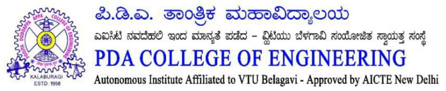


PDA COLLEGE OF ENGINEERING, KALABURAGI
Department of Artificial Intelligence and Machine Learning
Smart Appliance Energy Monitor Using Non-Intrusive Load Monitoring (NILM)
PROJECT GUIDE
TEAM MEMBERS
Prof. Soumya Gaitond
Hamsa V. Madamshetty Bhargavi G. Kulkarni Akshay A. Poddar Abhijeet Biranalli

Slide 2
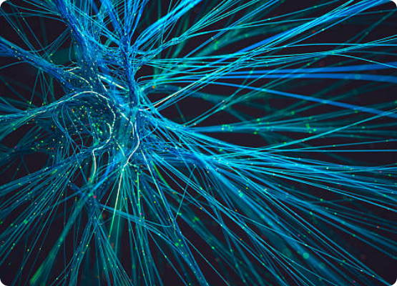

Abstract
The Smart Appliance Energy Monitor using Non-Intrusive Load Monitoring (NILM) is a prototype-based energy management system that analyzes aggregated household power consumption data to identify individual appliance usage without requiring separate sensors. Using publicly available datasets and machine learning frameworks such as Tensor Flow and Keras, the system classifies common appliances based on their power consumption patterns. An interactive dashboard visualizes energy usage trends, helping users understand and optimize electricity consumption. This prototype demonstrates the application of Artificial Intelligence and Machine Learning in smart energy management, offering a cost-effective and scalable approach to promoting energy efficiency and sustainable electricity usage.
PDA College of Engineering | AI & ML Dept
Slide 2

Slide 3
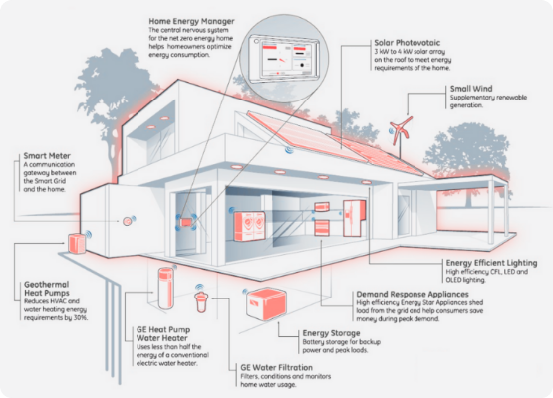
Introduction
Increasing use of electrical appliances has surged energy consumption.
Machine learning enables intelligent analysis of power signatures.
Monitoring electricity usage directly helps reduce wastage and cost.
Traditional methods require expensive separate sensors for every device.
NILM provides appliance-level monitoring using aggregate power data.
PDA College of Engineering | AI & ML Dept
Slide 3

Slide 4
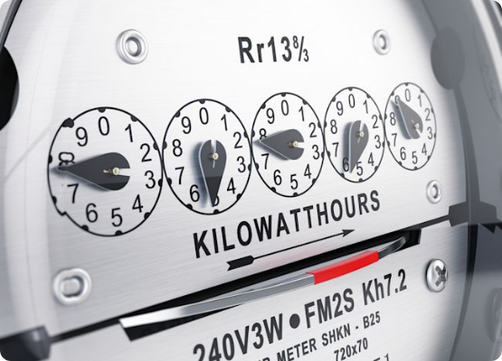
Problem Statement
Critical need for a smart, unified, and cost-effective solution.
Users only receive total electricity consumption information.
Existing monitoring systems are highly expensive and complex.
Installing multiple sensors significantly increases hardware cost.
Lack of appliance-wise information directly causes energy wastage.
PDA College of Engineering | AI & ML Dept
Slide 4

Slide 5
Objectives
Monitor household energy consumption remotely.
Analyze distinct appliance usage patterns.
Perform efficient preprocessing and feature extraction.
Use TensorFlow and Keras for precise classification.
Visualize energy consumption via interactive UI.
Promote sustainable and energy-efficient practices.
PDA College of Engineering | AI & ML Dept
Slide 5

Slide 6














Proposed System
1. Data Collection
2. Data Preprocessing
3. Feature Extraction
4. Machine Learning Model
5. Appliance Classification
6. Dashboard Visualization
PDA College of Engineering | AI & ML Dept
Slide 6

Slide 7
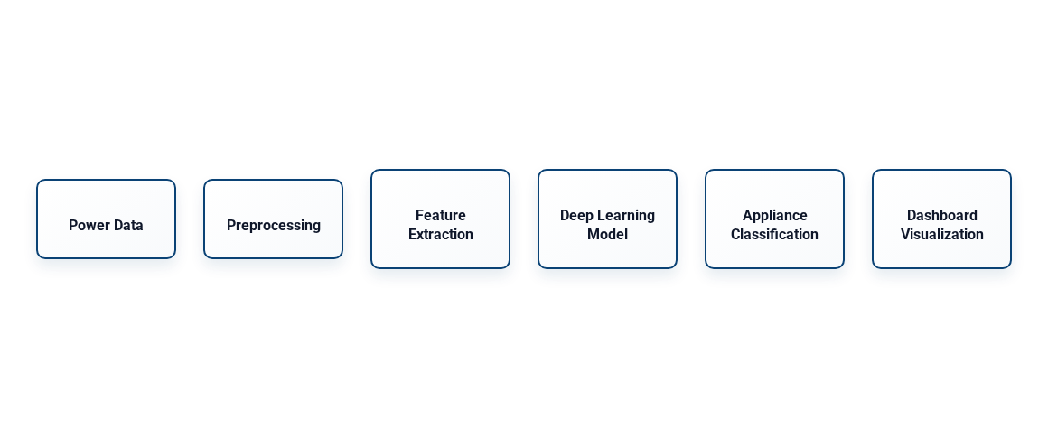
System Architecture
PDA College of Engineering | AI & ML Dept
Slide 7

Slide 8



Implementation
Software Requirements
Hardware Requirements
Python 3.x
Intel i5 Processor or above
TensorFlow
8 GB RAM Minimum
Keras
256 GB Storage (SSD preferred)
Pandas
NumPy
Streamlit
PDA College of Engineering | AI & ML Dept
Slide 8

Slide 9
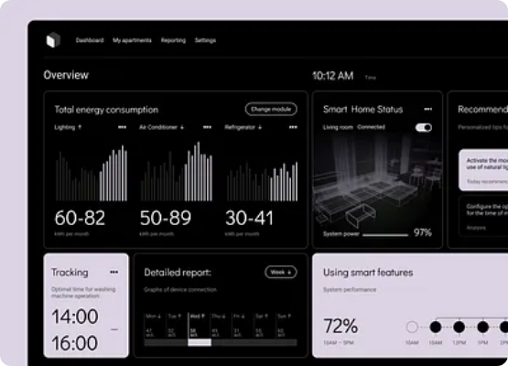
Results and Discussion
Appliance usage patterns are successfully and accurately identified.
Proved to be a highly scalable energy monitoring solution.
High-energy appliances are distinguished using unique power signatures.
Interactive dashboard heavily improves end-user awareness.
Significantly reduced hardware requirements compared to traditional methods.
PDA College of Engineering | AI & ML Dept
Slide 9

Slide 10
Conclusion and Future Scope
The Smart Appliance Energy Monitor using Non-Intrusive Load Monitoring (NILM) is a cost-effective prototype for analyzing household energy consumption. It uses aggregate power data to identify appliance usage without requiring separate sensors for each device. The system demonstrates the application of Artificial Intelligence and Machine Learning in modern energy management. An interactive dashboard helps users visualize energy consumption patterns and improve energy awareness.
The prototype reduces hardware complexity while supporting efficient electricity utilization. It also highlights the potential of NILM technology for smart home applications.
Overall, the project provides a scalable and user-friendly approach to energy monitoring and conservation. Future enhancements such as IoT integration, real-time monitoring, and advanced deep learning techniques can further improve its accuracy, performance, and practical usability.
PDA College of Engineering | AI & ML Dept
Slide 10

Slide 11
THANK YOU

